Slide 1
Kindergarten Awards Ceremony
Mrs. Schaffner’s Kindergarten Class
2020-2021

Slide 2
Memorable Moments from our year
Masks and social distancing
Lots of birthday parties
Playground time
Fun Centers
Morning bins
ABC backwards countdown days
Chromebooks

Slide 3
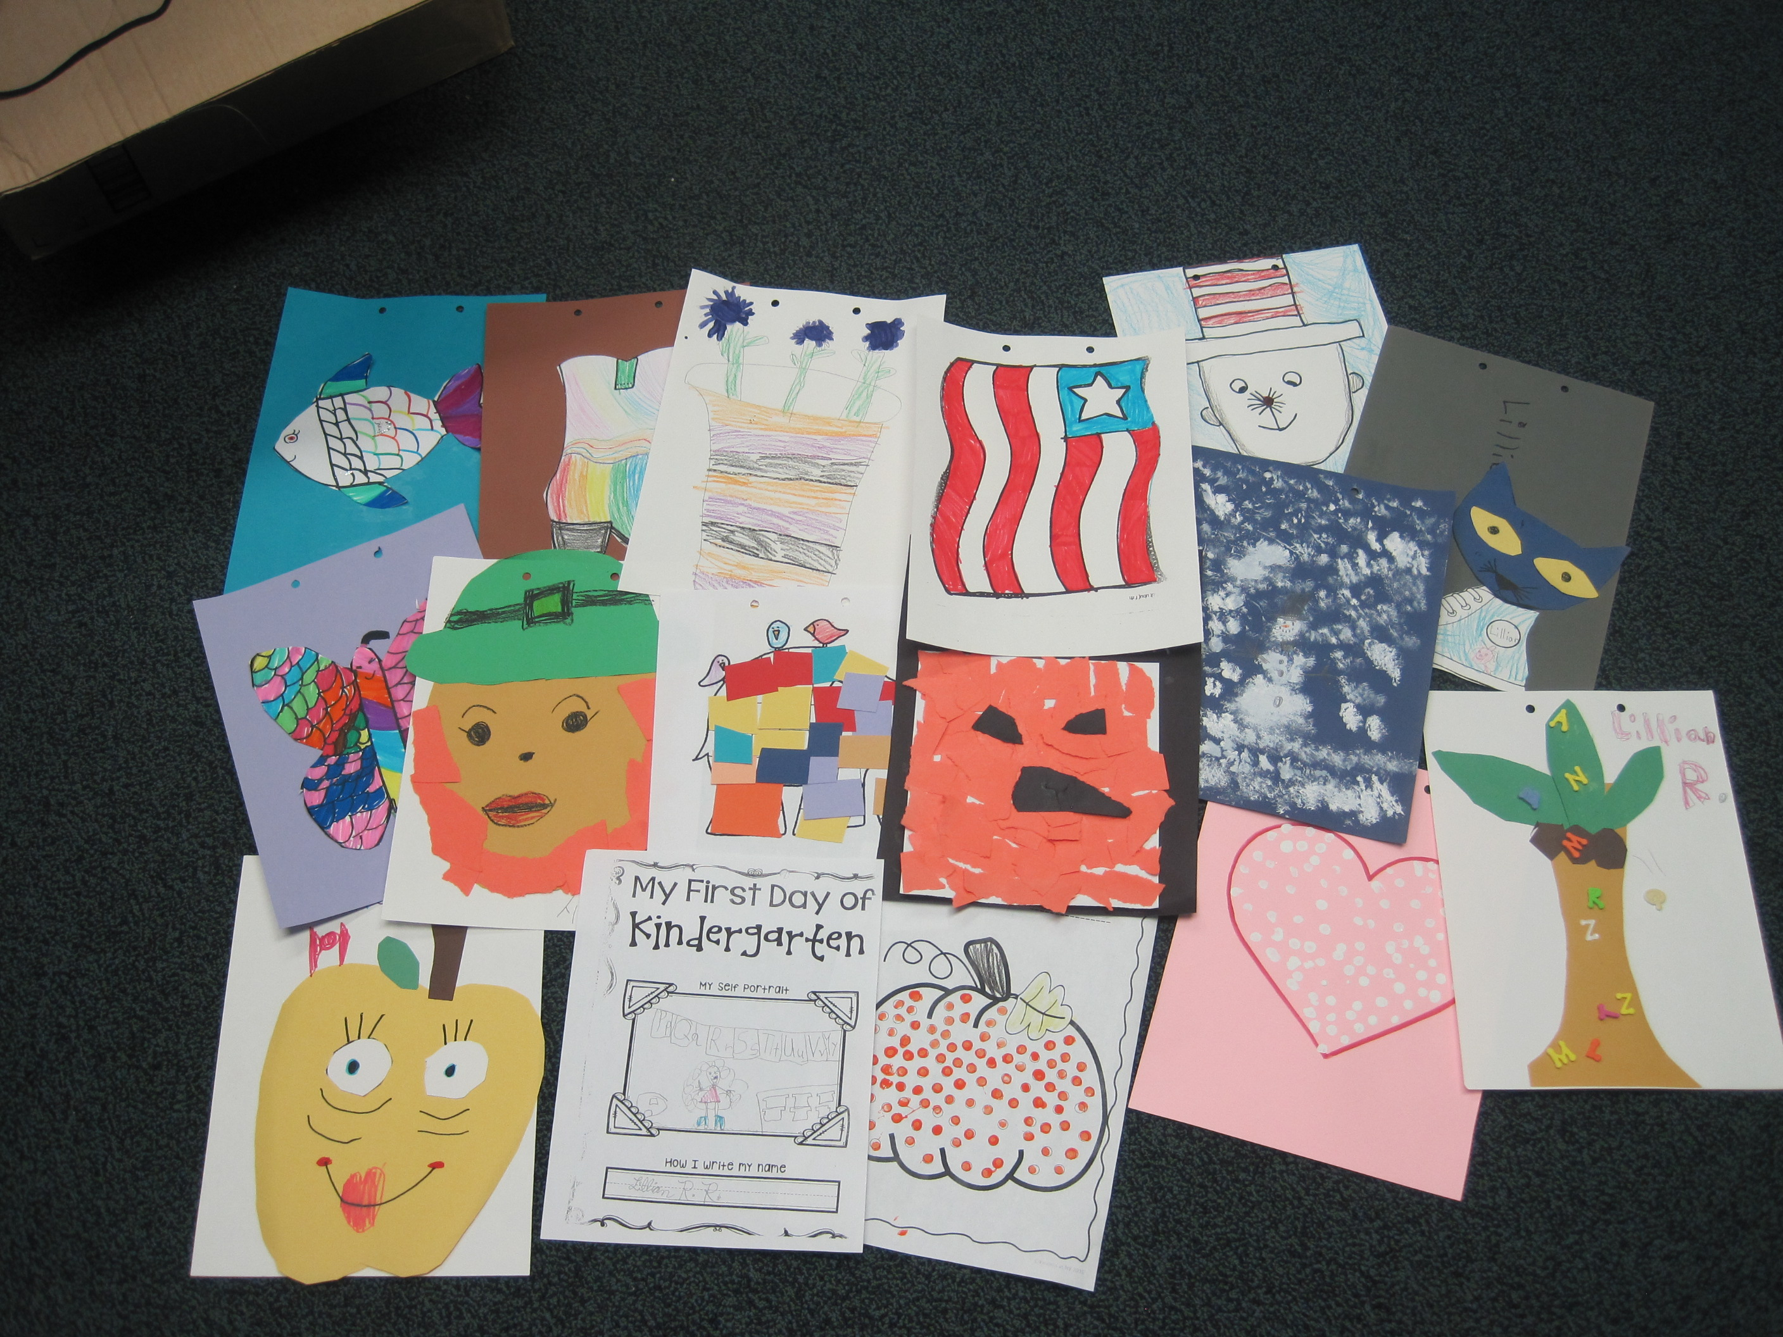
Kindergarten Scrapbook
Your child’s artwork for the year has been compiled into a scrapbook for the year.

Slide 4
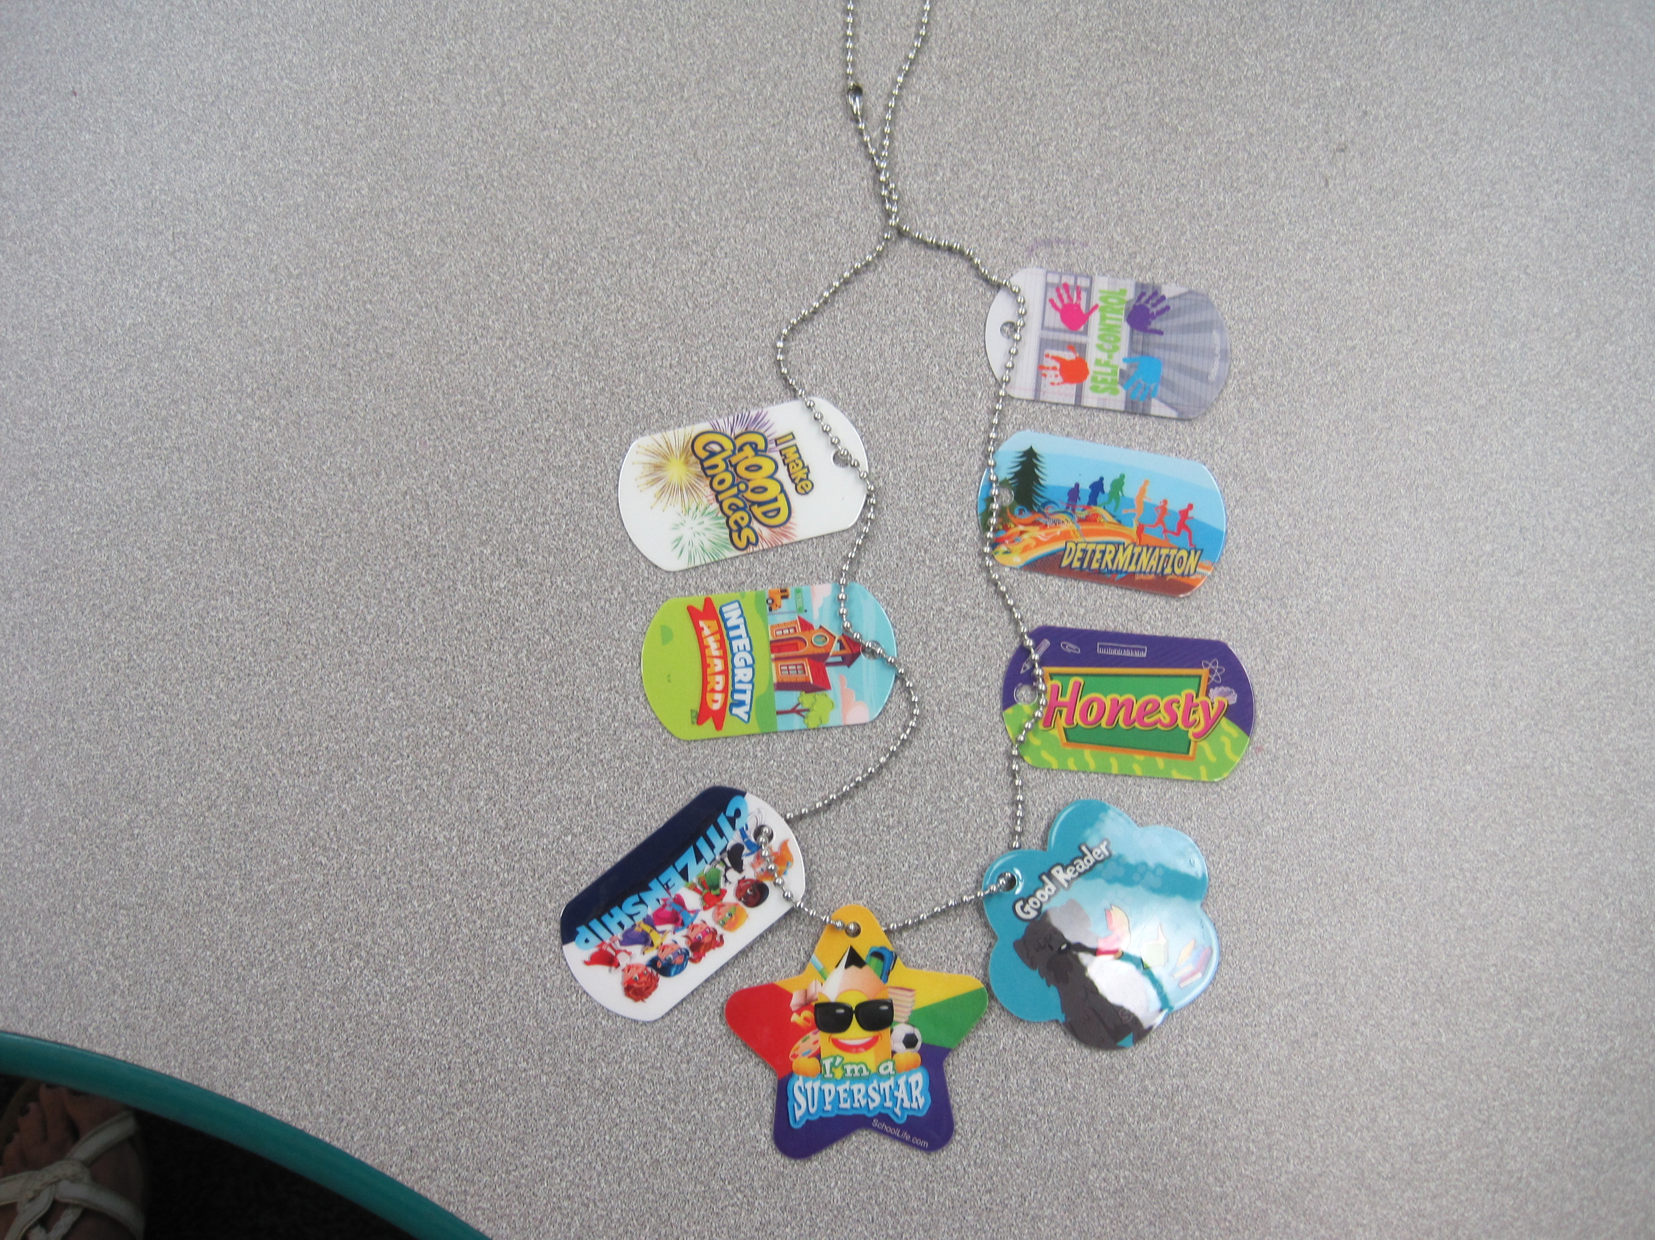
Brag Tags
This year Kate Sullivan used brag tags to reward students for Citizenship, Honor Roll and great work. Your child has a brag tag in their envelope. The number of tags on your child’s necklace are the ones your child earned. Not everyone has the same number of tags. All students did great job earning bag tags.

Slide 5
Caleb Porter
June 4, 2021
Mrs. Schaffner

Slide 6
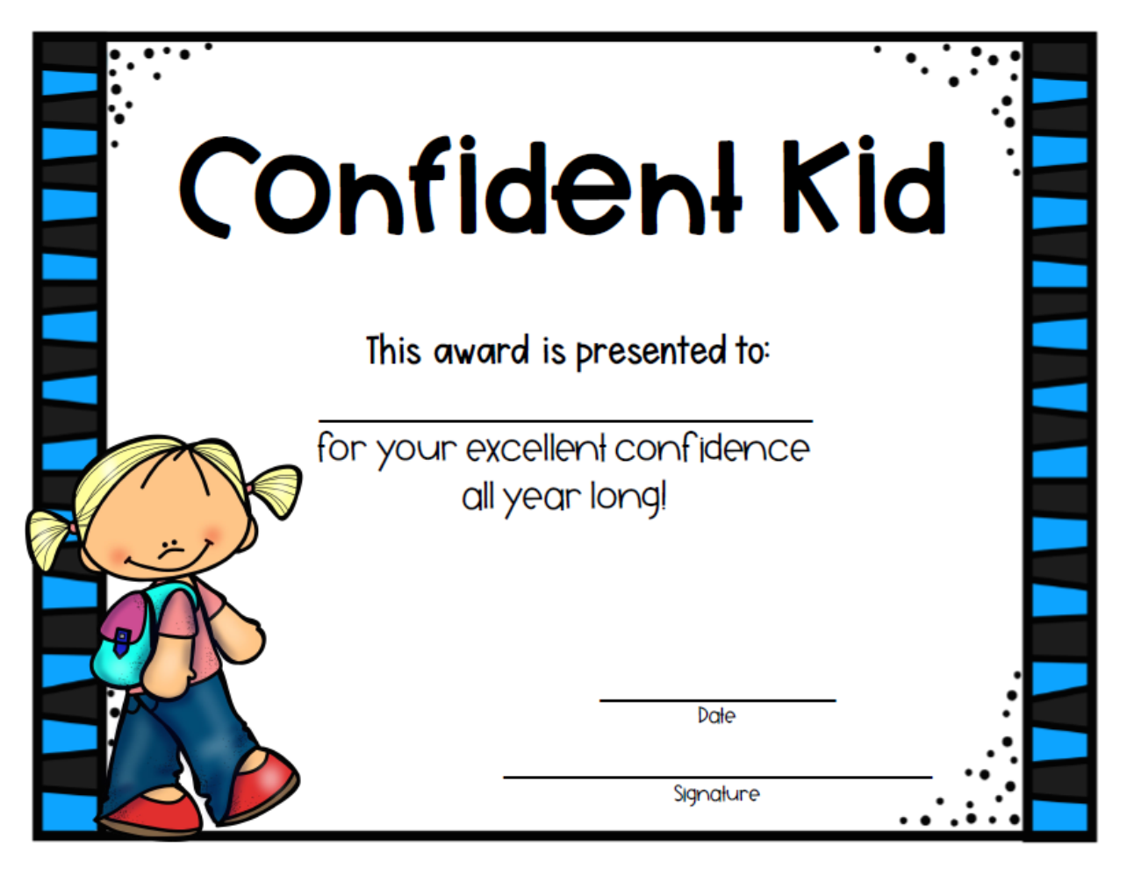
Sakura Ramos
June 4, 2021

Slide 7
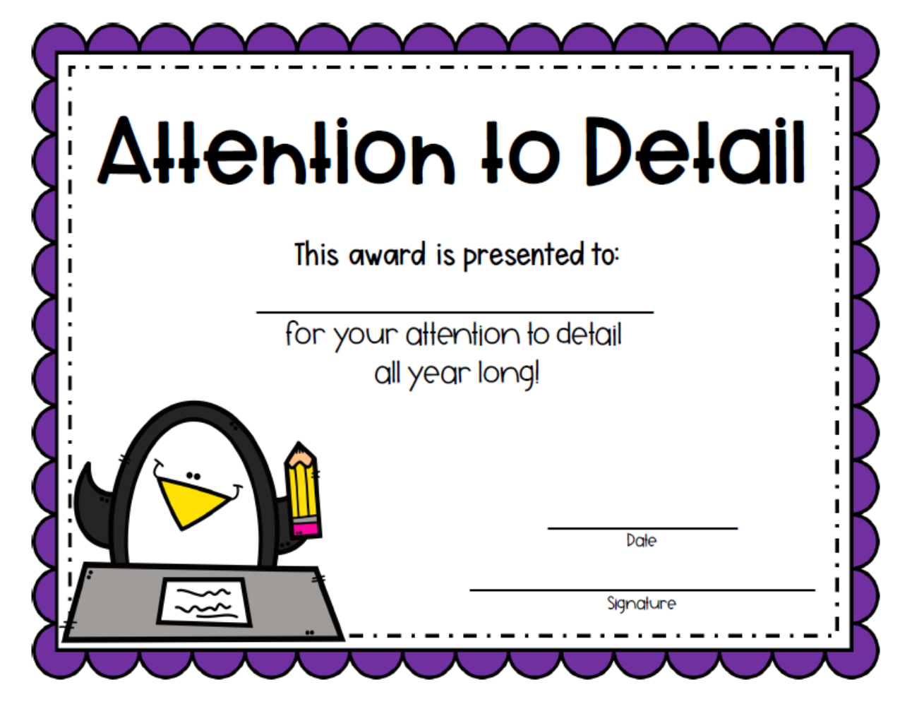
Mason Shaffer
June 4, 2021

Slide 8
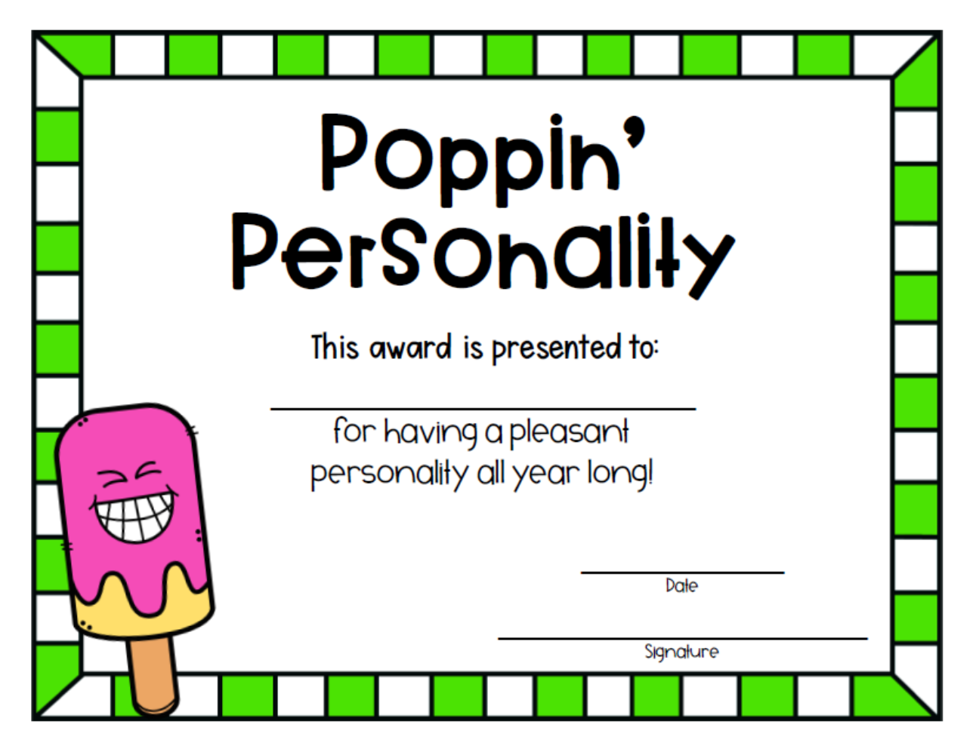
Micah Tyson
June 4, 2021

Slide 9
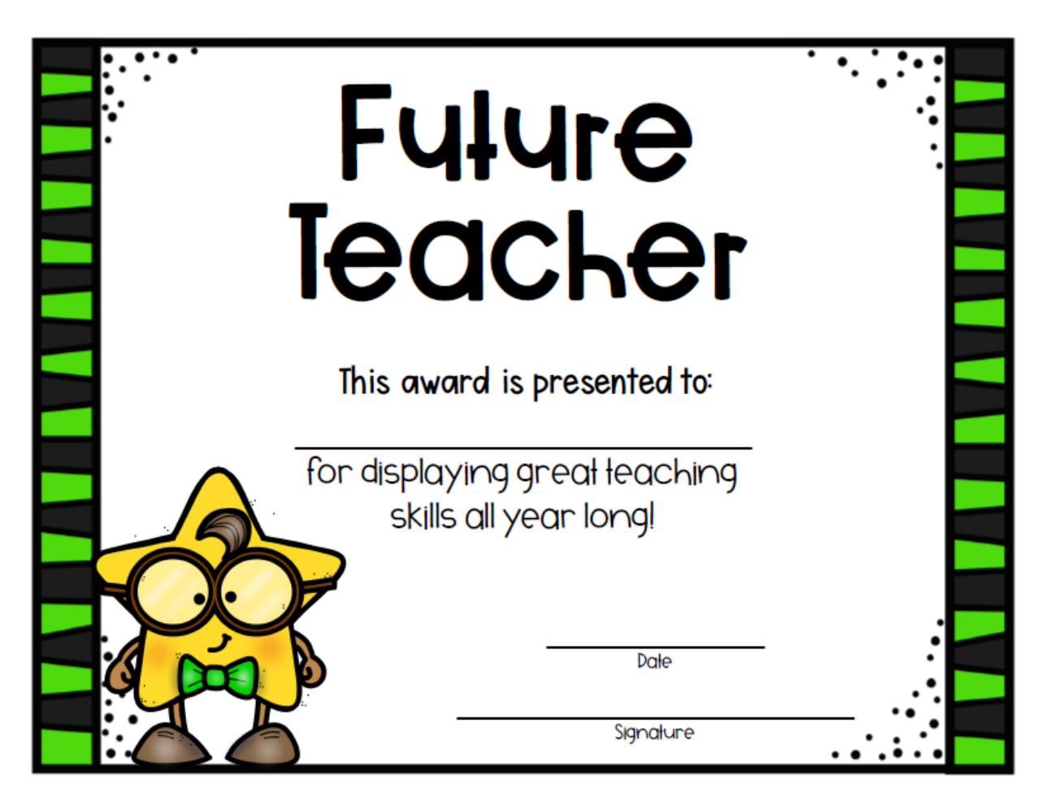
Lillian Reynolds
June 4, 2021

Slide 10
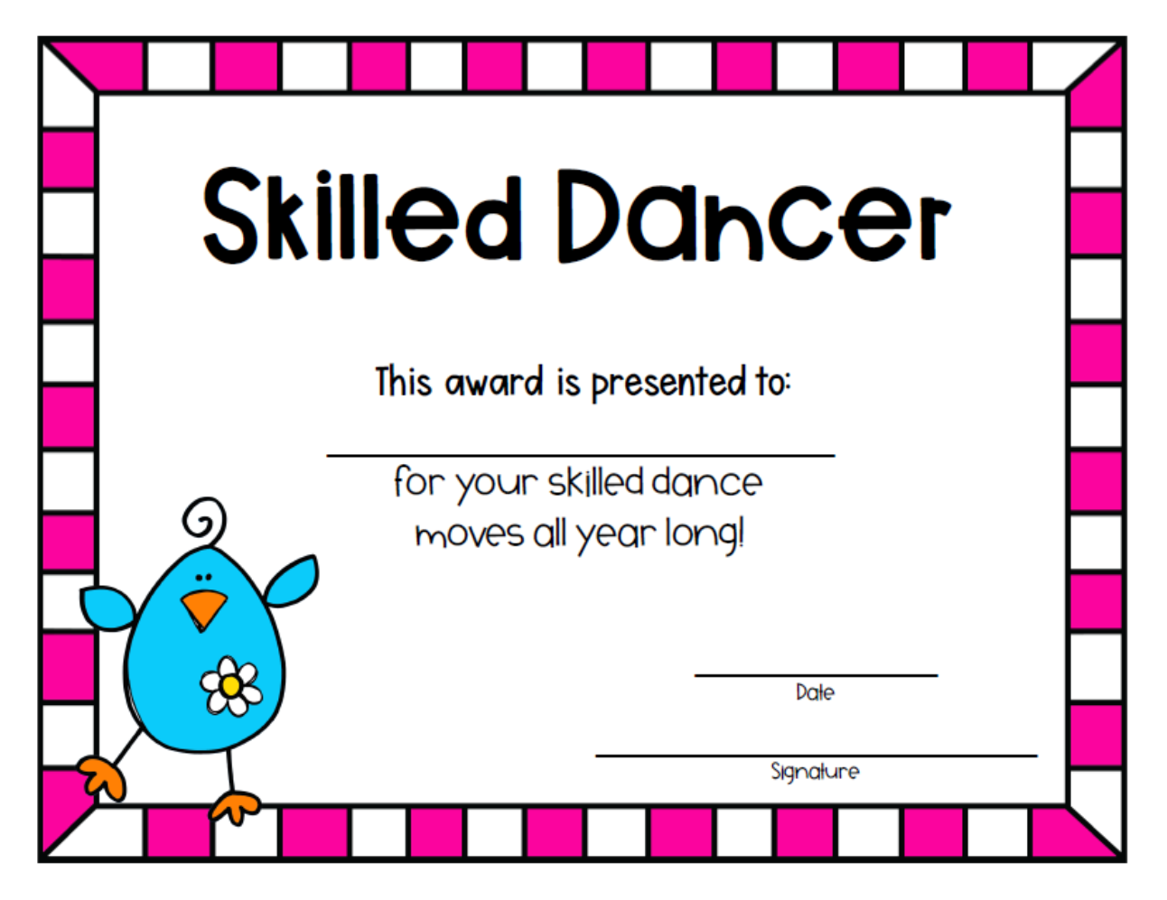
Elias Roa
June 4, 2021

Slide 11
Ava Tran
June 4, 2021

Slide 12
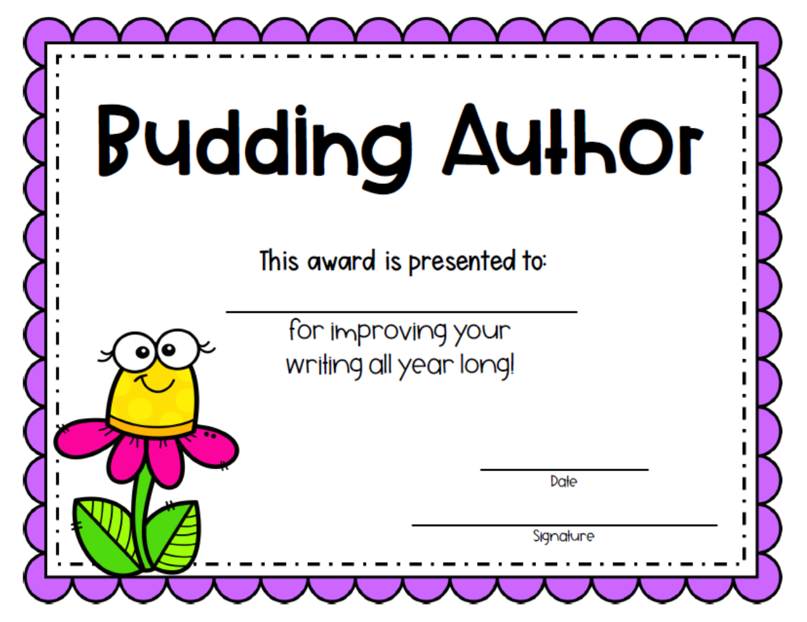
Kylan Norris
June 4, 2021

Slide 13
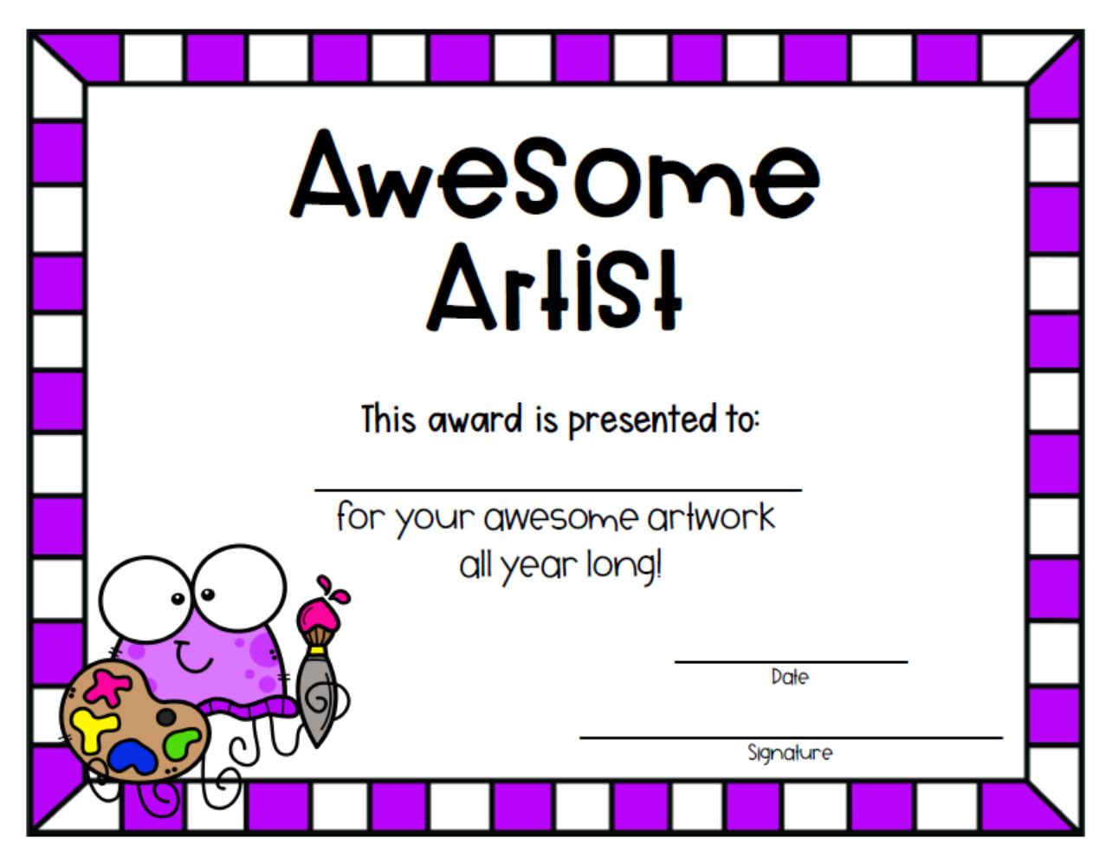
Sam Allbritton
June 4, 2021

Slide 14
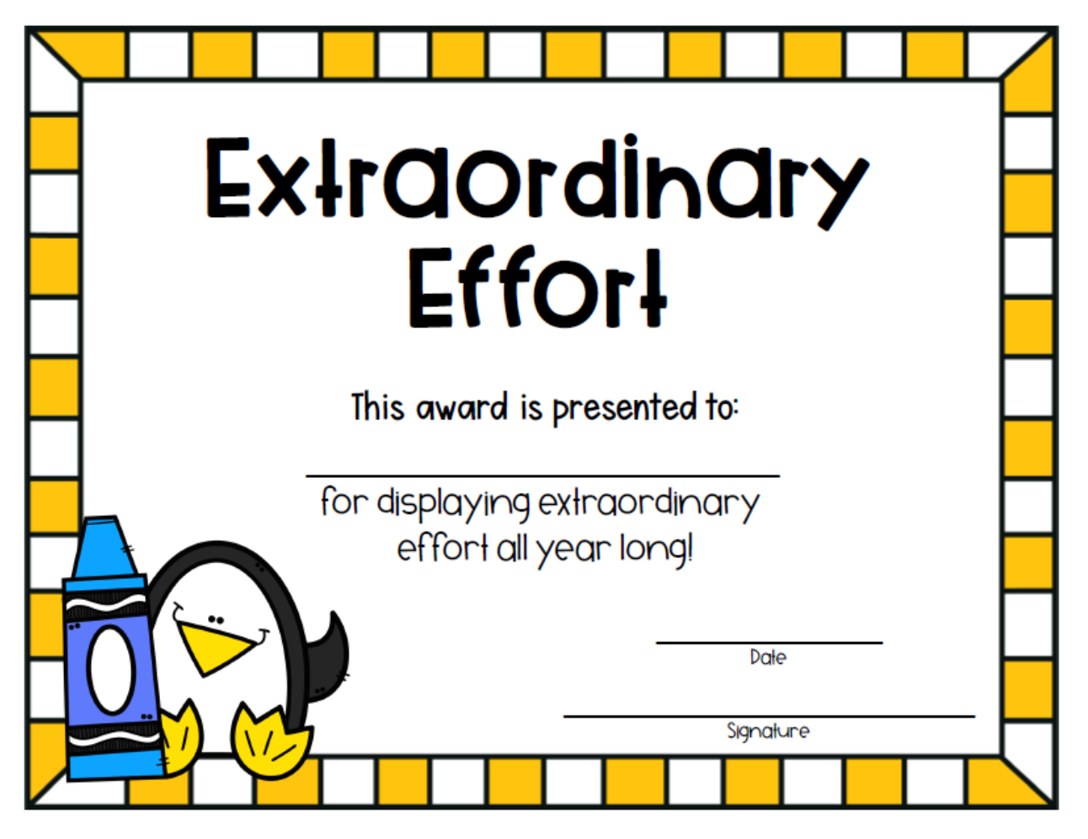
Riley Anne Defibaugh
June 4, 2021

Slide 15
Jayson Easom
June 4, 2021

Slide 16
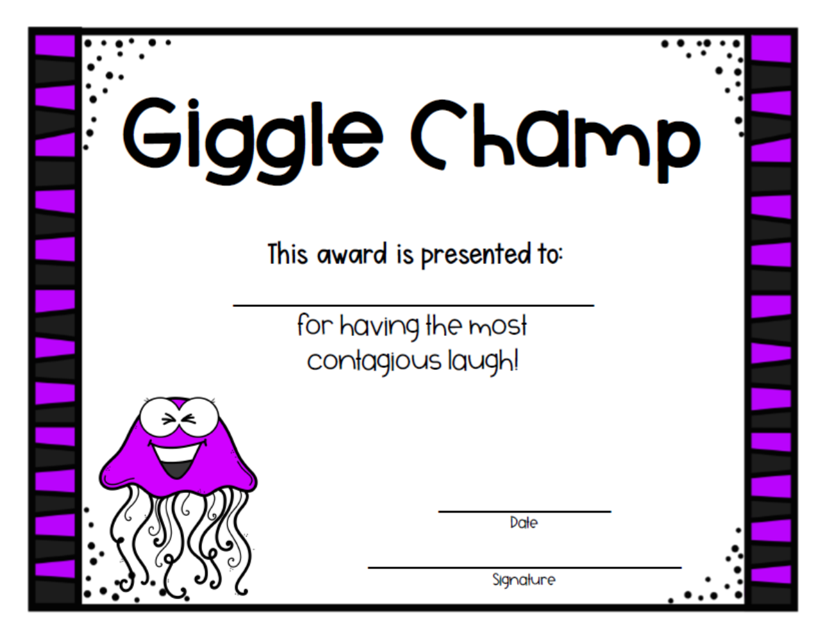
Yesania Sapp
June 4, 2021

Slide 17
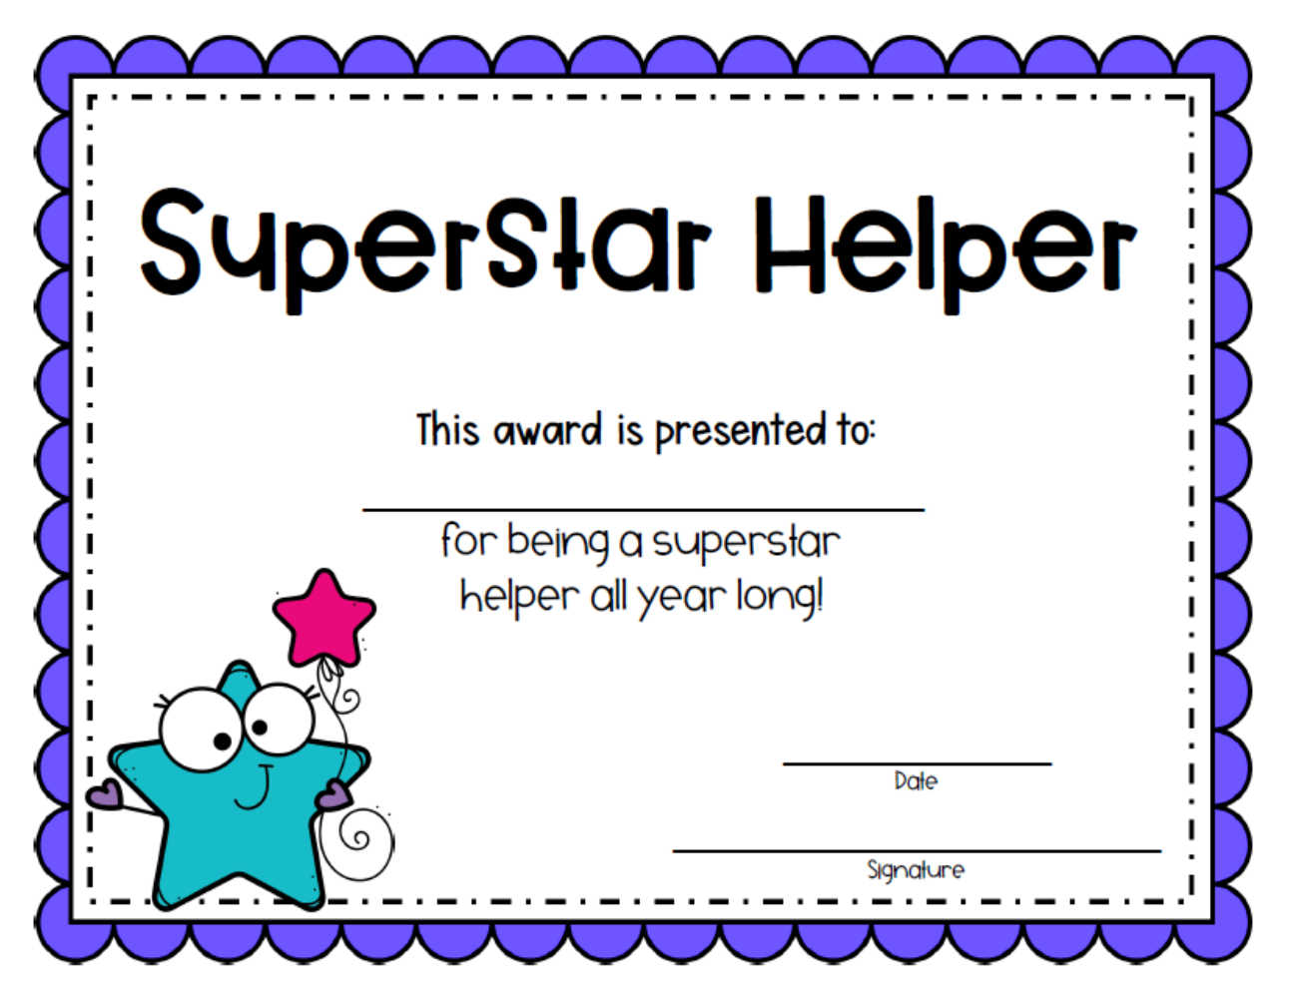
Ronald Mills
June 4, 2021

Slide 18
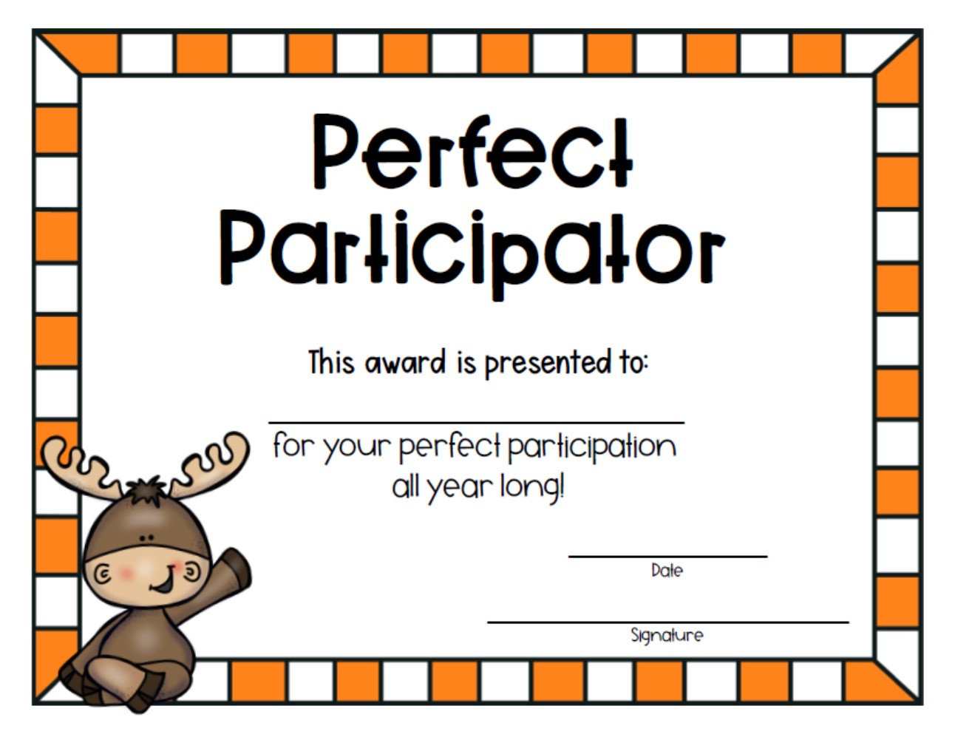
Emani Sawyer
June 4, 2021

Slide 19
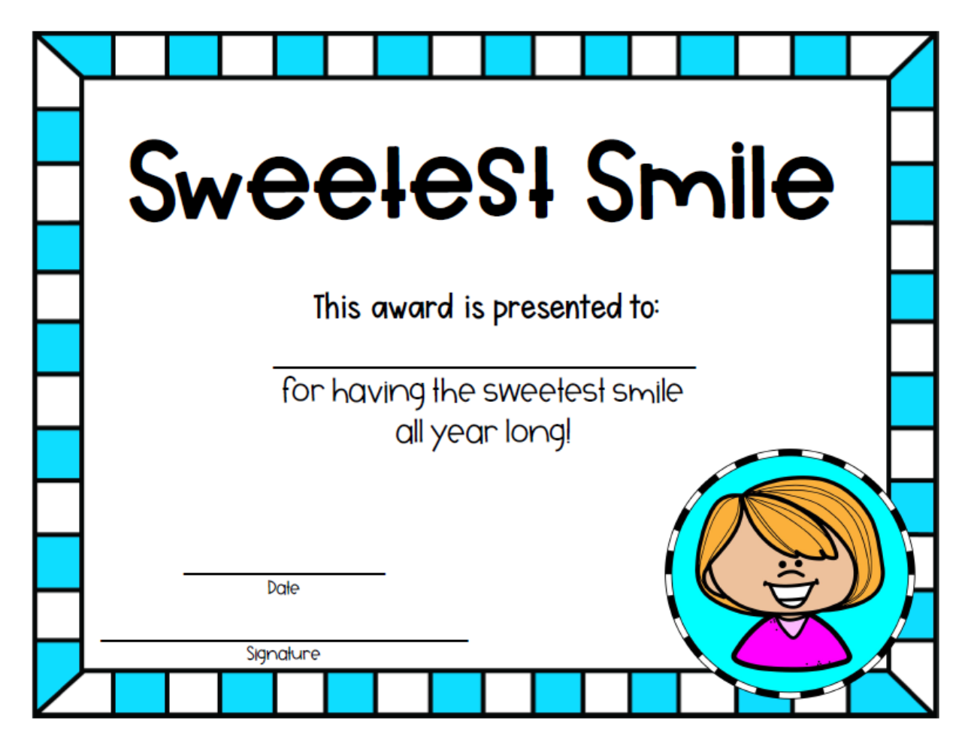
Sydney Kilgore
June 4, 2021

Slide 20
Robert Hall
June 4, 2021

Slide 21
Layan Darwish
June 4, 2021

Slide 22
Wali Odom
June 4, 2021

Slide 23
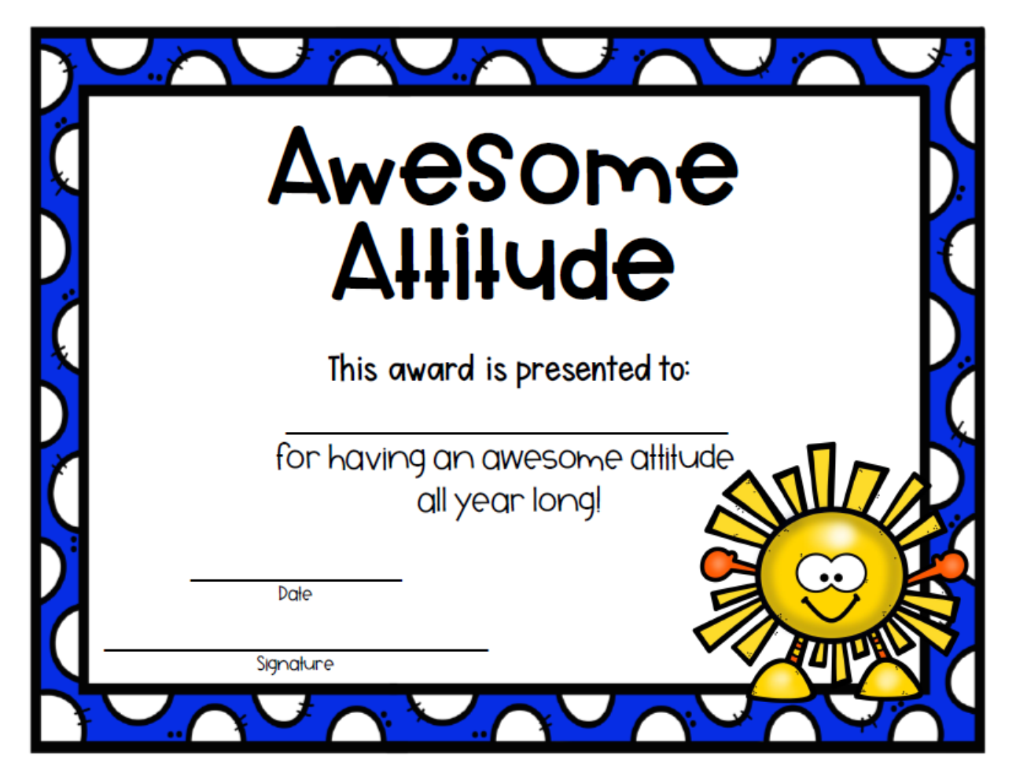
Taniah Ford
June 4, 2021

Slide 24
Summer Learning Bags
Through a Donorschoose Project, I was able to purchase a Summer Learning Bag for each student.
Each bag has three picture books, set of kid’s card games, Summer workbook, crayons, pencils, and a summer activity calendar.
My hope is that your child will be able to have a fun summer and not lose the skills they have learned this year.
Summer Learning Bags will come home on Monday.

Slide 25
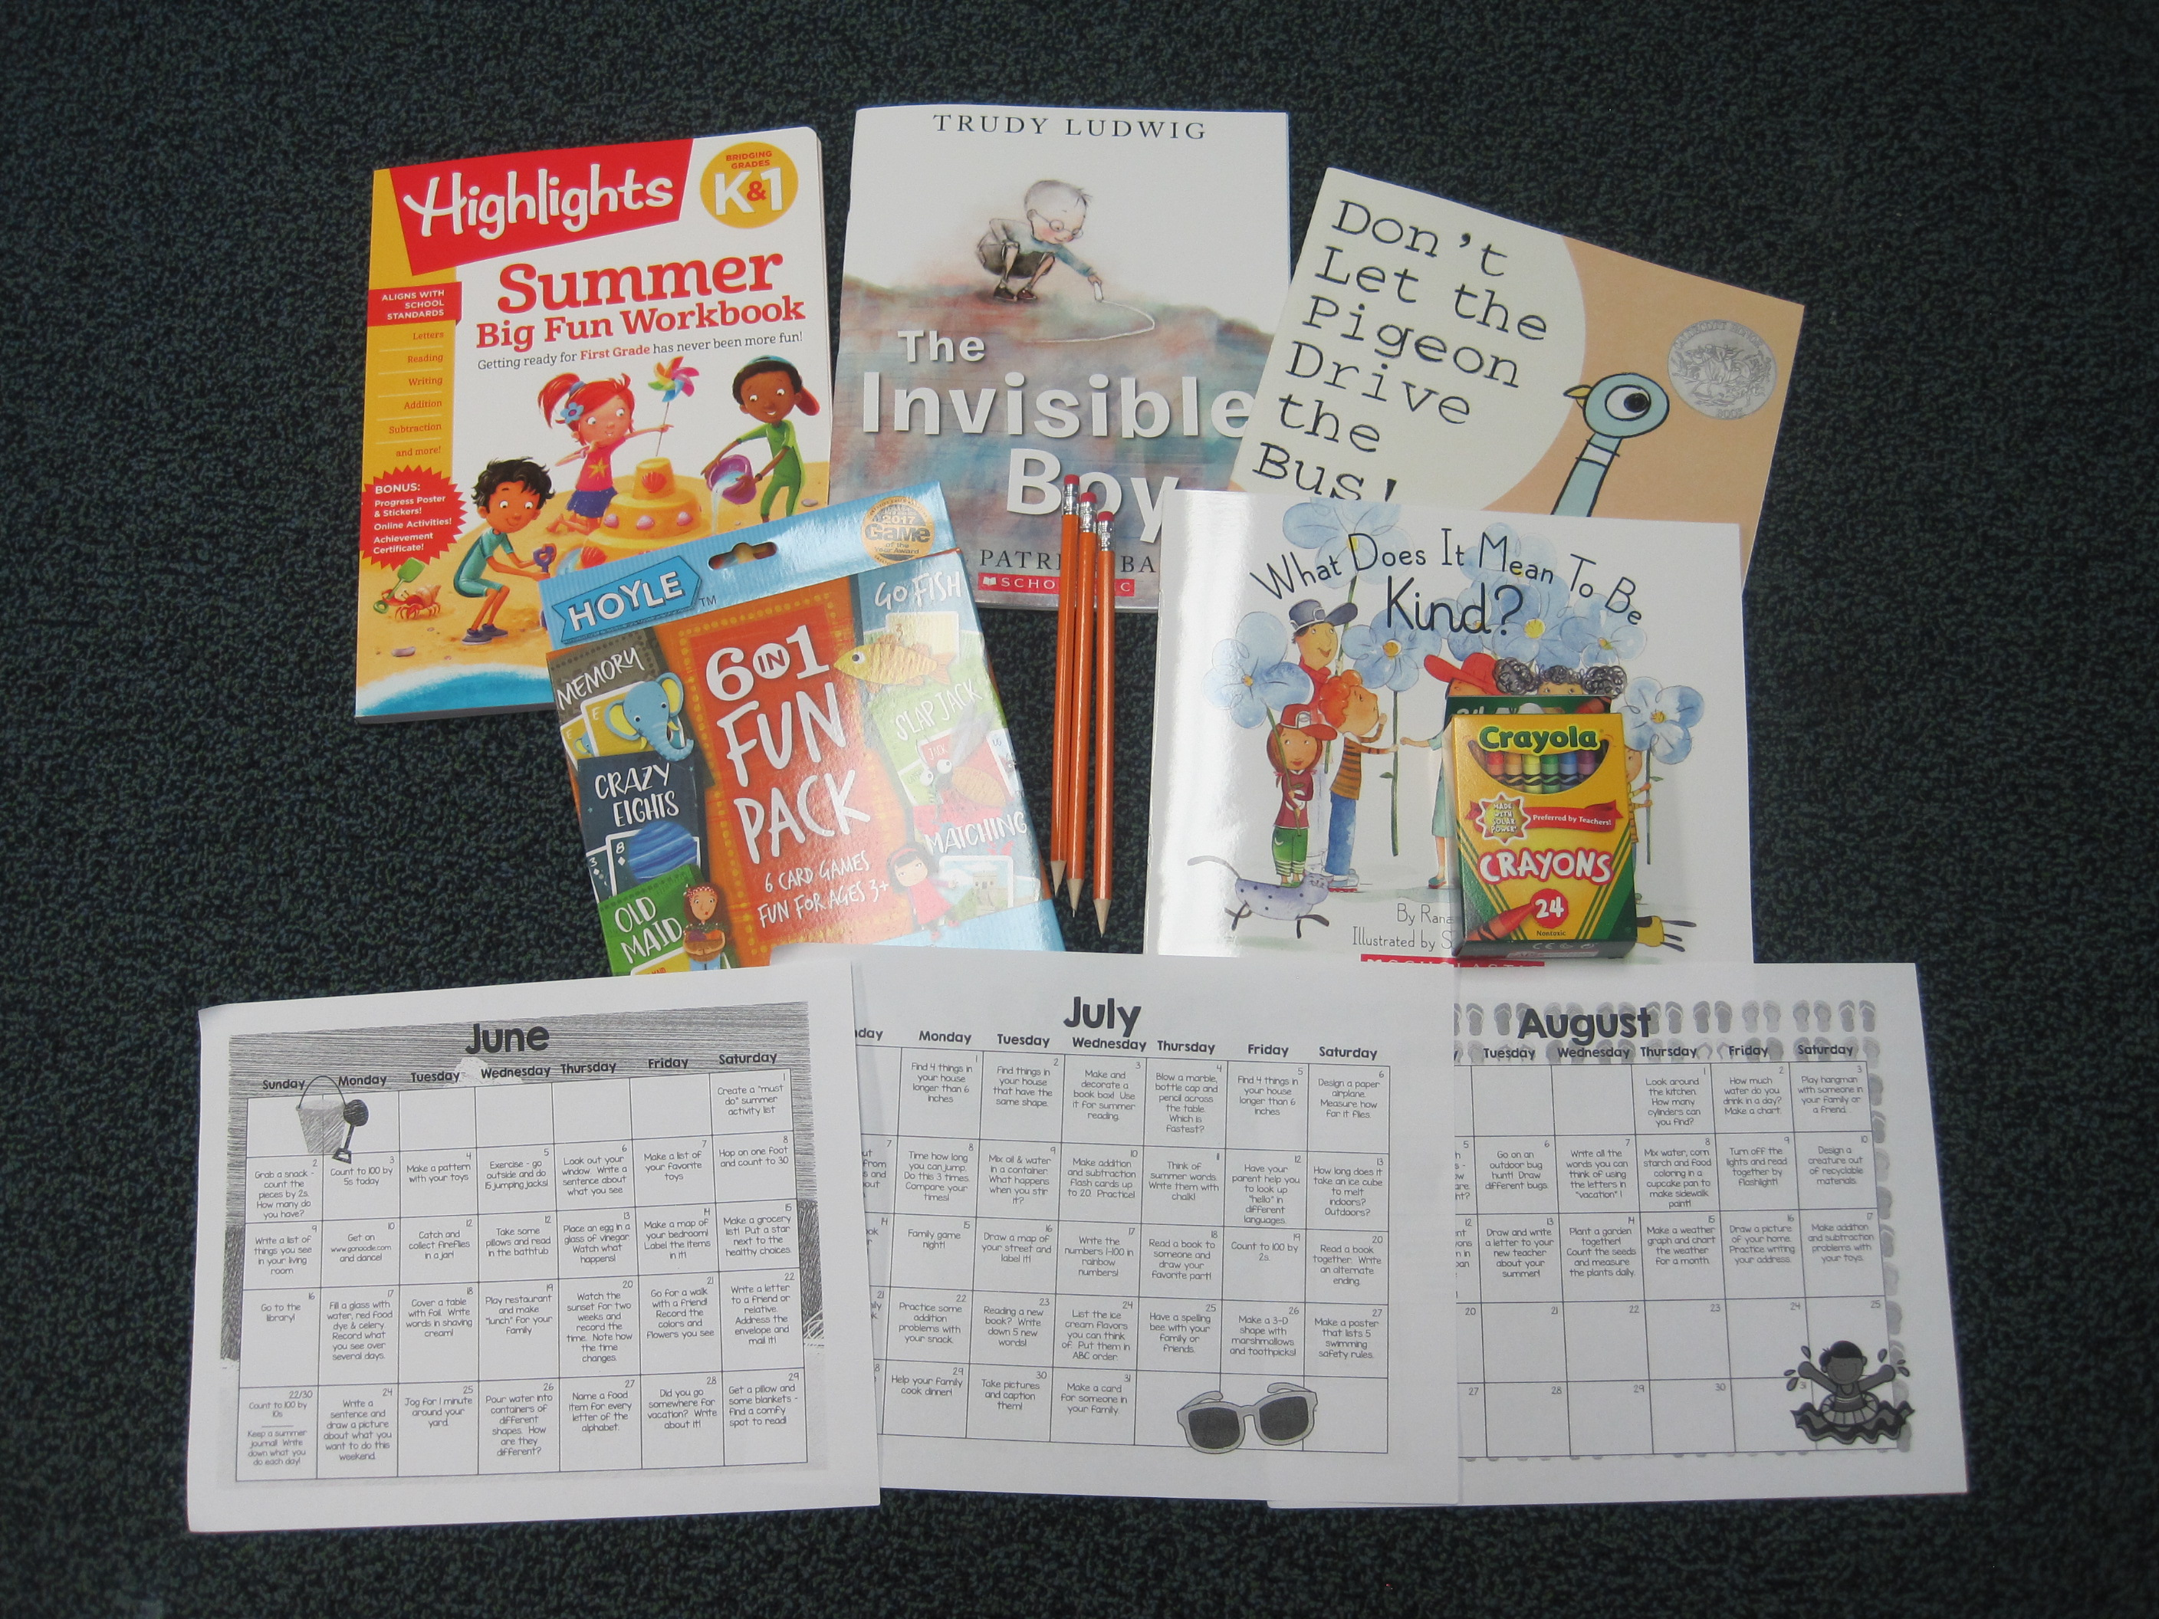
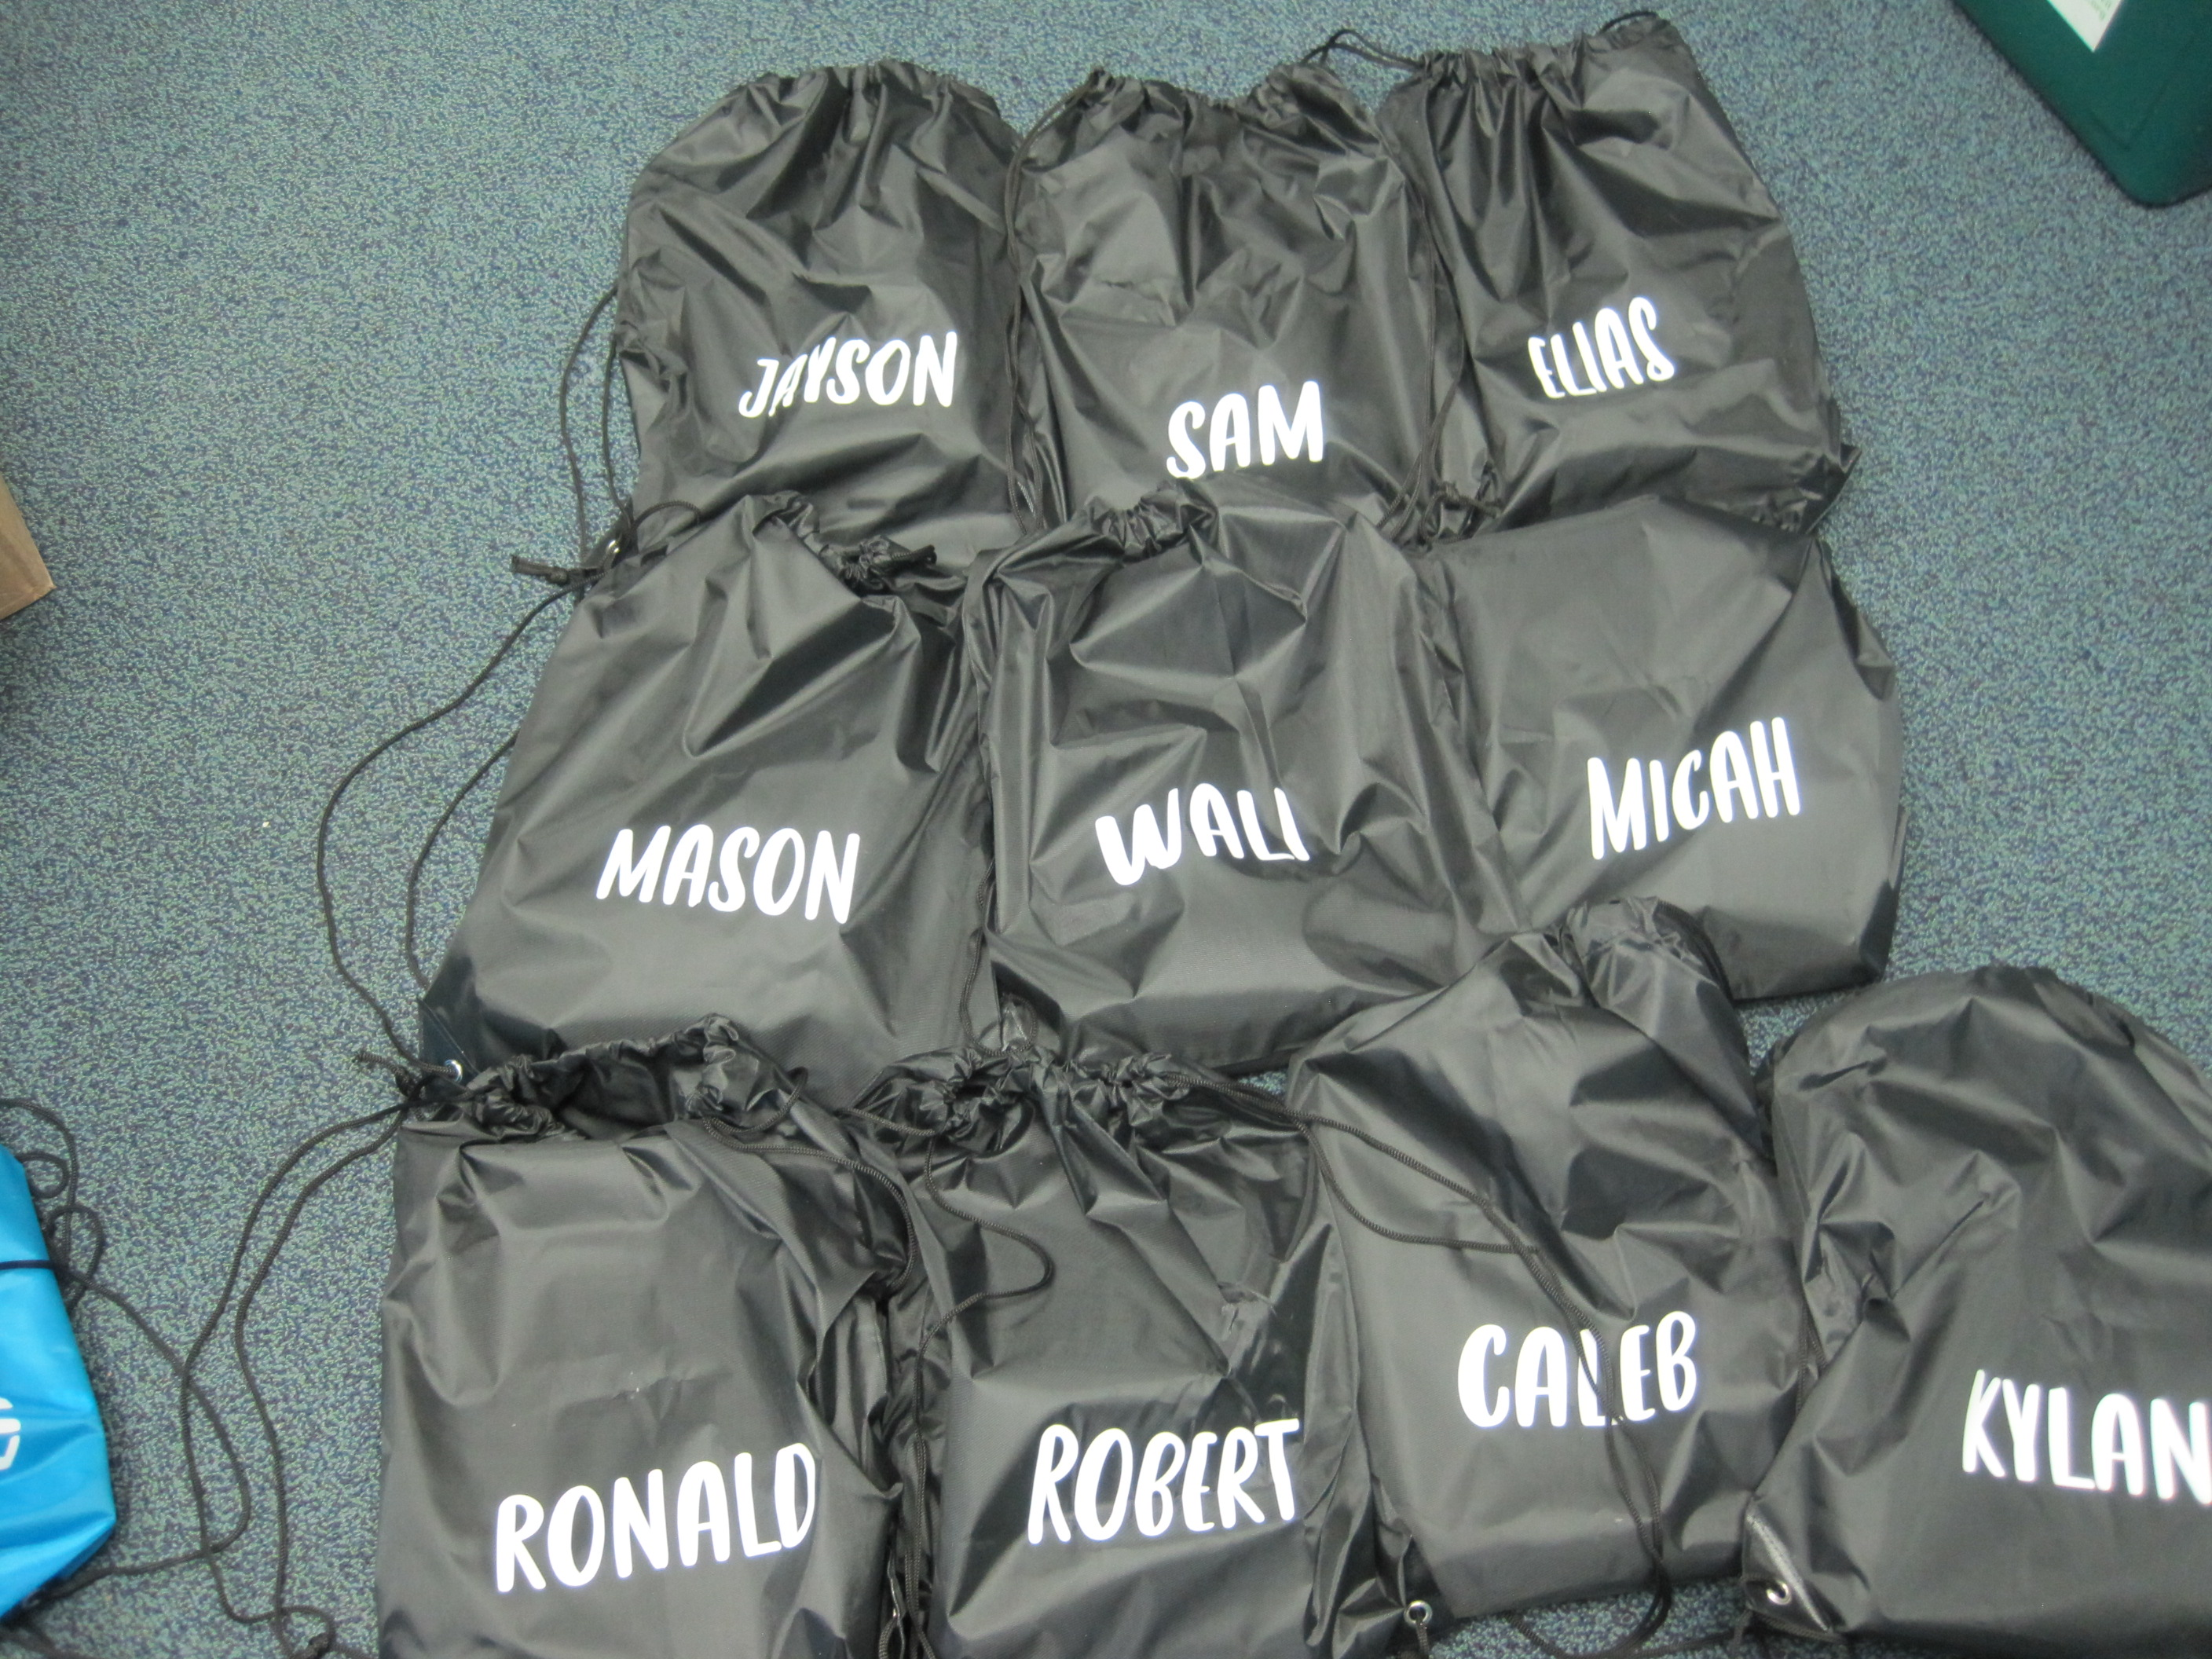
Summer Learning Bags

Slide 26
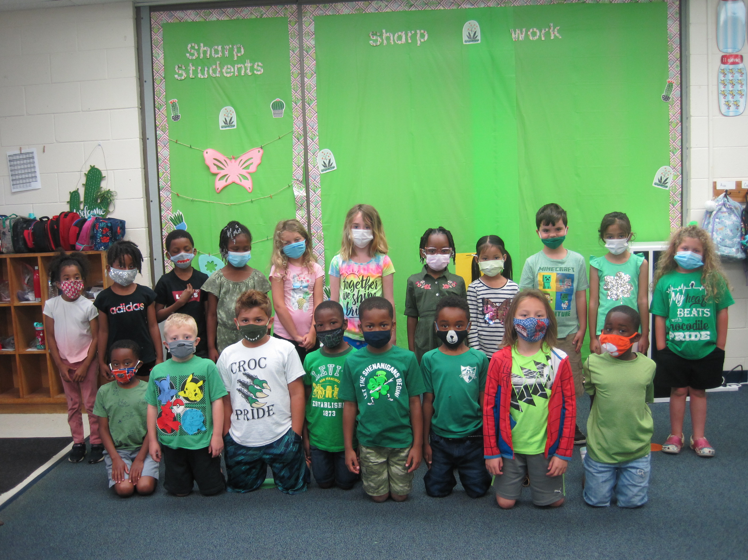
WE HAD A GREAT YEAR TOGETHER! Thank you for all your support!

